Slide 1
Javadoc

Slide 2
Input
/**
* Returns an Image object that can then be painted on the screen.
* The url argument must specify an absolute {@link URL}. The name
* argument is a specifier that is relative to the url argument.
* <p>
* This method always returns immediately, whether or not the
* image exists. When this applet attempts to draw the image on
* the screen, the data will be loaded. The graphics primitives
* that draw the image will incrementally paint on the screen.
*
* @param url an absolute URL giving the base location of the image
* @param name the location of the image, relative to the url argument
* @return the image at the specified URL
* @see Image
*/
public Image getImage(URL url, String name) {
try { return getImage(new URL(url, name));
} catch (MalformedURLException e) { return null; }
}

Slide 3
HTML Output
getImage
public Image getImage(URL url, String name)
  Returns an Image object that can then be painted on the screen. The url argument must specify an absolute URL. The name argument is a specifier that is relative to the url argument. This method always returns immediately, whether or not the image exists. When this applet attempts to draw the image on the screen, the data will be loaded. The graphics primitives that draw the image will incrementally paint on the screen.
  Parameters:
    url - an absolute URL giving the base location of the image
    name - the location of the image, relative to the url argument
  Returns:
    the image at the specified URL
  See Also:
    Image

Slide 4
Overview Tags
Include tags in the following order:
@see (additional references)
@since (since what version/ since when is it available?)
@author (classes and interfaces only, required.)
@version (classes and interfaces only, required.)
{@link}(Inserts an in-line link to another topic)
{@linkplain}(Inserts an in-line link to another topic, but the link is displayed in a plain-text font.)
{@docRoot} (Specifies the path to the root directory of the current documentation)

Slide 5
Package Tags
Include tags in the following order:
@see (additional references)
@since (since what version/ since when is it available?)
@author (classes and interfaces only, required.)
@version (classes and interfaces only, required.)
{@link}(Inserts an in-line link to another topic)
{@linkplain}(Inserts an in-line link to another topic, but the link is displayed in a plain-text font.)
{@docRoot} (Specifies the path to the root directory of the current documentation)

Slide 6
Class/Interface Tags
Include tags in the following order:
@see (additional references)
@since (since what version/ since when is it available?)
@deprecated (Specifies that a class or member is deprecated.)
@author (classes and interfaces only, required.)
@version (classes and interfaces only, required.)
{@link}(Inserts an in-line link to another topic)
{@linkplain}(Inserts an in-line link to another topic, but the link is displayed in a plain-text font.)
{@docRoot} (Specifies the path to the root directory of the current documentation)

Slide 7
Field Tags
Include tags in the following order:
@see (additional references.)
@since (since what version/ since when is it available?)
@deprecated (Specifies that a class or member is deprecated.)
{@link}(Inserts an in-line link to another topic.)
{@linkplain}(Inserts an in-line link to another topic, but the link is displayed in a plain-text font.)
{@docRoot} (Specifies the path to the root directory of the current documentation.)
{@value} (Displays the value of a constant, which must be a static field.)

Slide 8
Method/Contructor Tags
Include tags in the following order:
@see (additional references)
@since (since what version/ since when is it available?)
@deprecated (Specifies that a class or member is deprecated.)
@param (Documents a method's parameter.)
@return (Documents a method's return value.)
@exception (Identifies an exception thrown by a method.)
@throws (Same as @exception.)
{@link}(Inserts an in-line link to another topic)
{@linkplain}(Inserts an in-line link to another topic, but the link is displayed in a plain-text font.)
  {@inheritDoc} (Inherits a comment from the immediate superclass.)
{@docRoot} (Specifies the path to the root directory of the current documentation)

Slide 9
Javadoc Tools

Slide 10
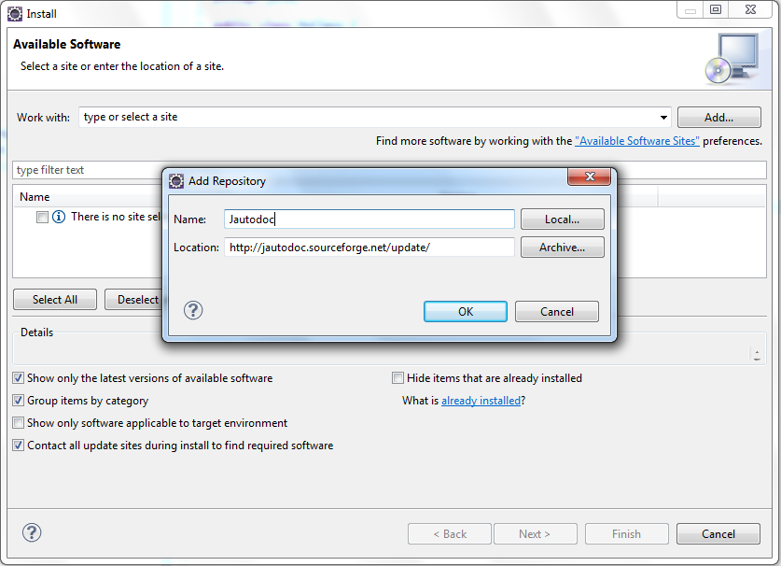
JAutodoc - Eclipse Plugin
Vào Help → Install New Software sau đó điền vào ô name và thêm đường link http://jautodoc.sourceforge.net/update/ vào location.

Slide 11
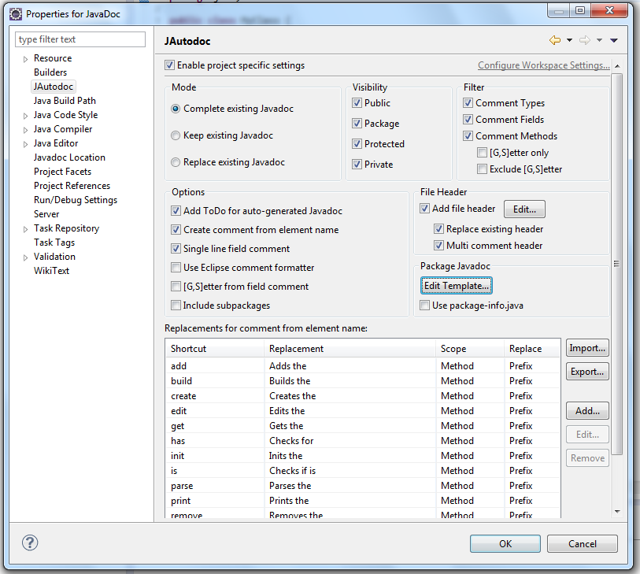
Cấu Hình JAutodoc
Sau khi cài đặt các bạn mở eclipse vào File → Properties → JAutodoc. Các bạn có thể chỉnh sửa header, template cho javadoc

Slide 12
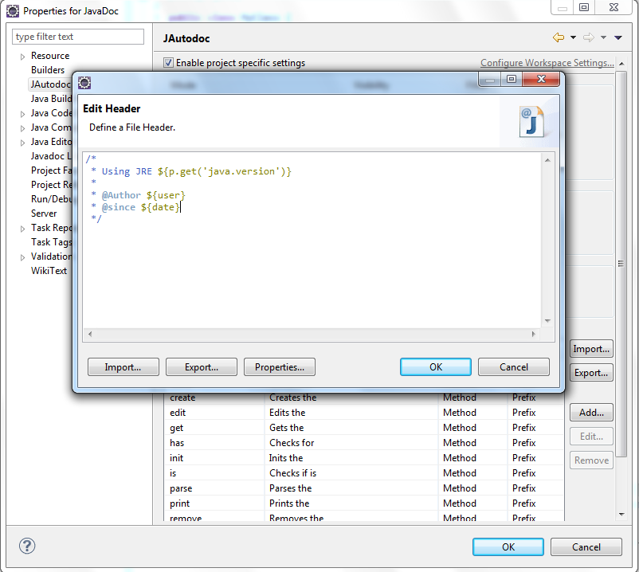
Cấu Hình JAutodoc (tt.)
Ở đây mình cấu hình mẫu một cái header của javadoc

Slide 13
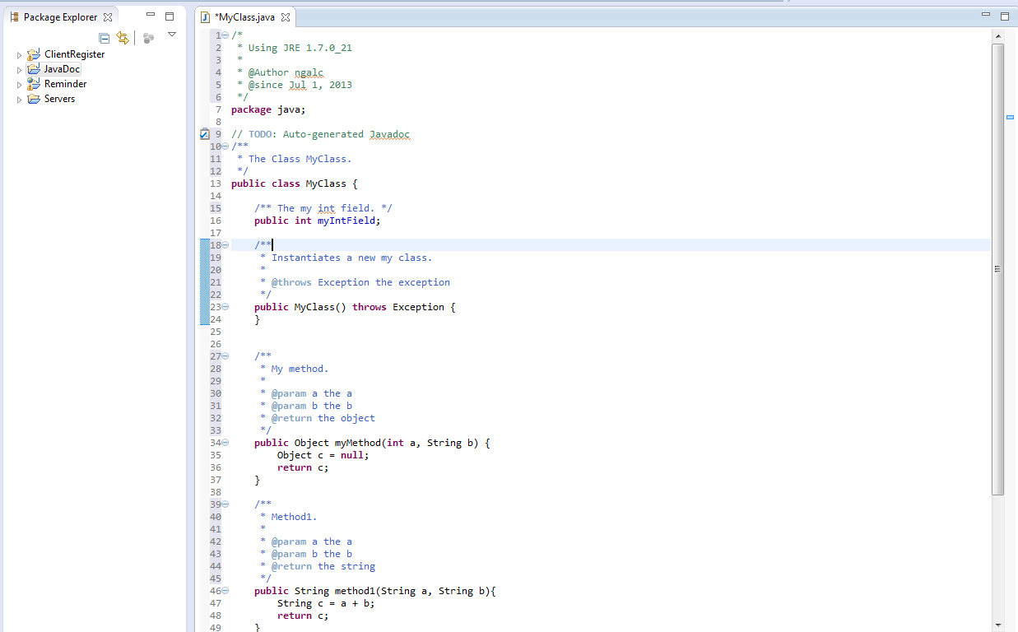
Sử Dụng JAutodoc
Đầu tiên vào eclipse tạo một project bình thường sau đó sử dụng tổ hợp phím Alt+Ctrl+J để tự động thêm comment sau đó thêm mô tả chi tiết cho các function dựa theo quy tắc của javadoc

Slide 14
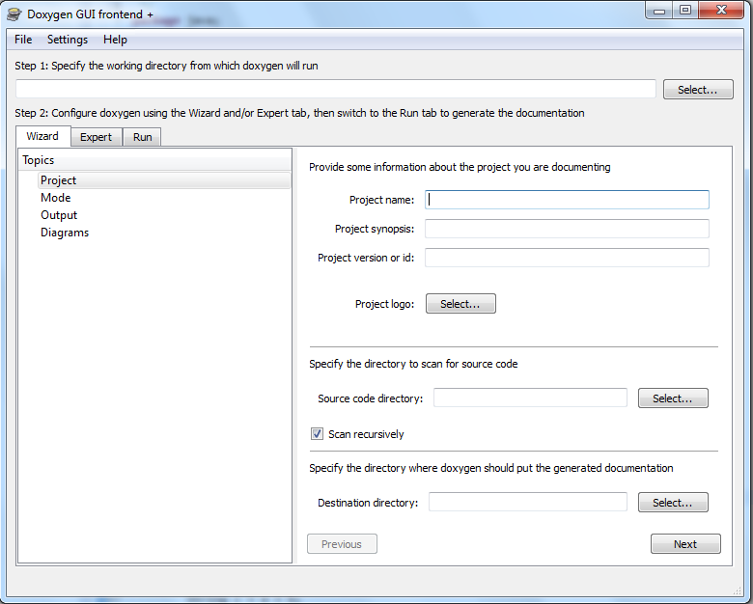
Phần Mềm Doxygen
Các bạn tải và cài đặt Doxygen từ website http://www.stack.nl/~dimitri/doxygen/download.html. Giao diện chính của Doxygen GUI như sau:

Slide 15
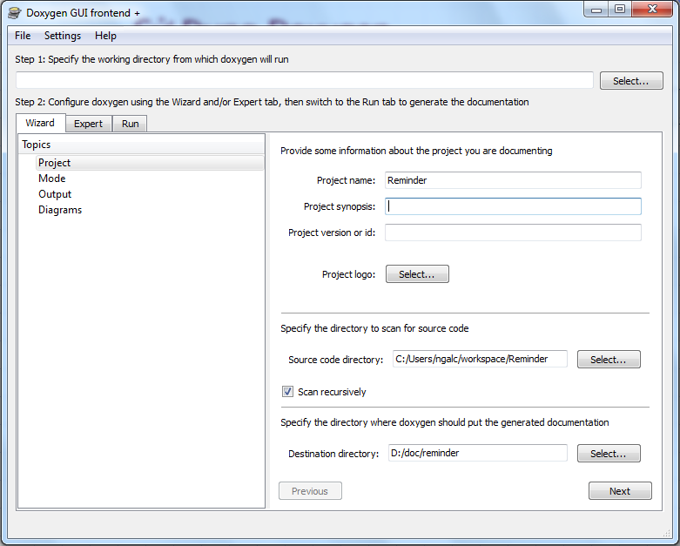
Sử Dụng Doxygen
Đầu tiên các bạn điền đầy đủ thông tin của project như sau
Tên Project
Thư mục chứa
source code
Thư mục sẽ
chứa javadoc

Slide 16
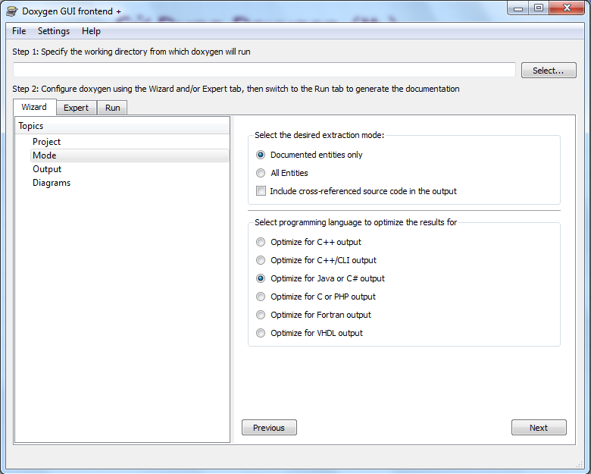
Sử Dụng Doxygen (tt.)
Chỉnh các thông tin về mode tạo ra javadoc

Slide 17
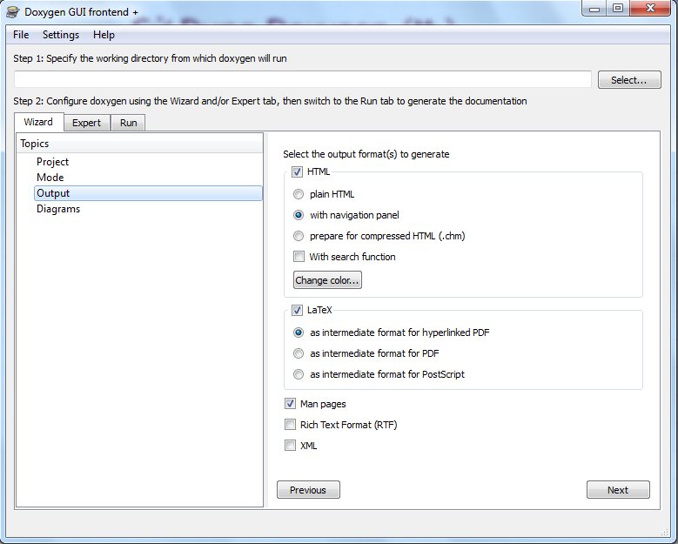
Sử Dụng Doxygen (tt.)
Sửa các thông tin và định dạng của file javadoc tạo ra

Slide 18
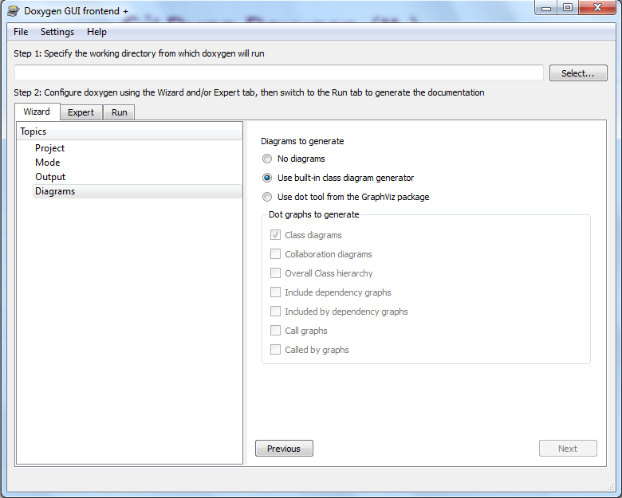
Sử Dụng Doxygen (tt.)
Chọn các thông tin để tự động tao ra diagram

Slide 19
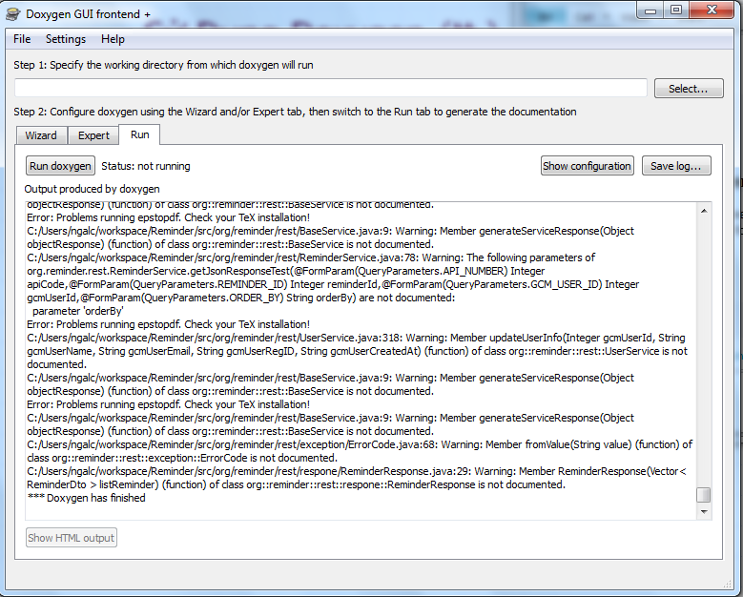
Sử Dụng Doxygen (tt.)
Cuối cùng sang tab Run để tạo ra javadoc

Slide 20
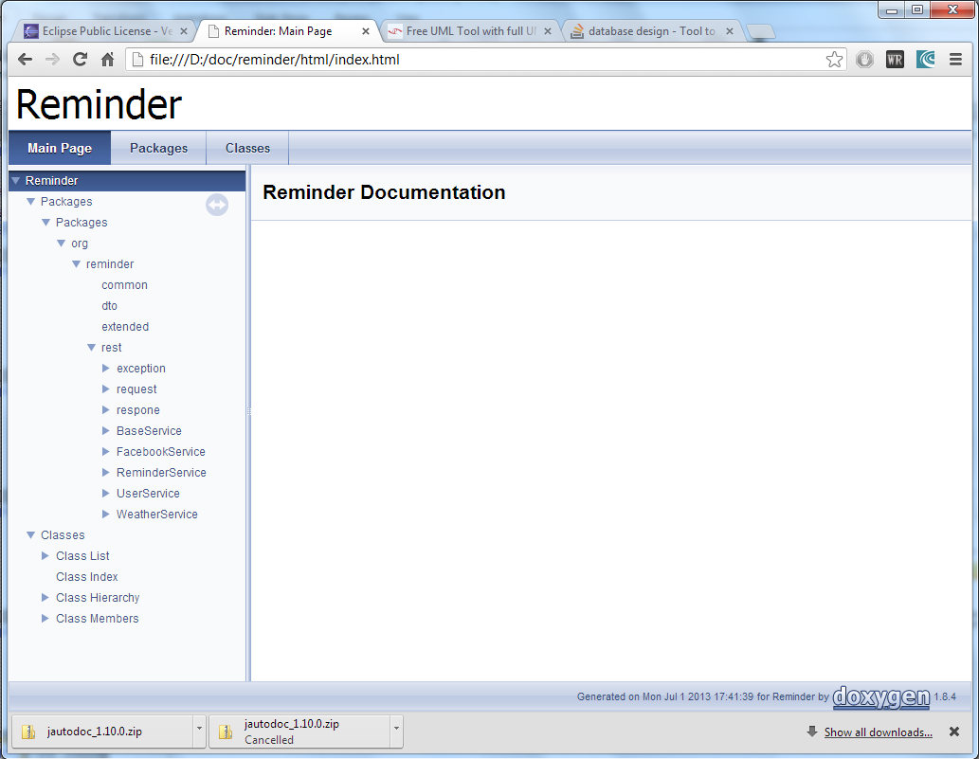
Giao Diện Javadoc

